Slide 1
Computer Fundamental and Cyber security

Slide 2
The invention of _______________ gave birth to the much cheaper micro computers. a) Mainframes b) Microcomputers c) Microprocessors d) PDAs
Notes:
c

Slide 3
PDA stands for? a) personal digital applications b) private digital applications c) personal digital assistants d) private digital assistants
Notes:
c

Slide 4
What is an operating system? a) interface between the hardware and application programs b) collection of programs that manages hardware resources c) system service provider to the application programs d) all of the mentioned
Notes:
d

Slide 5
In Operating Systems, which of the following is/are CPU scheduling algorithms? a) Priority b) Round Robin c) Shortest Job First d) All of the mentioned
Notes:
d

Slide 6
To access the services of the operating system, the interface is provided by the ___________ a) Library b) System calls c) Assembly instructions d) API
Notes:
b

Slide 7
If a process fails, most operating system write the error information to a ______ a) new file b) another running process c) log file d) none of the mentioned
Notes:
c

Slide 8
A deadlock avoidance algorithm dynamically examines the __________ to ensure that a circular wait condition can never exist. a) operating system b) resources c) system storage state d) resource allocation state
Notes:
d

Slide 9
In real time operating system ____________ a) process scheduling can be done only once b) all processes have the same priority c) kernel is not required d) a task must be serviced by its deadline period
Notes:
d

Slide 10
Operating System
Operating System lies in the category of system software. It basically manages all the resources of the computer. An operating system acts as an interface between the software and different parts of the computer or the computer hardware.
It controls and monitors the execution of all other programs that reside in the computer, which also includes application programs and other system software of the computer. Examples of Operating Systems are Windows, Linux, Mac OS, etc.

Slide 11
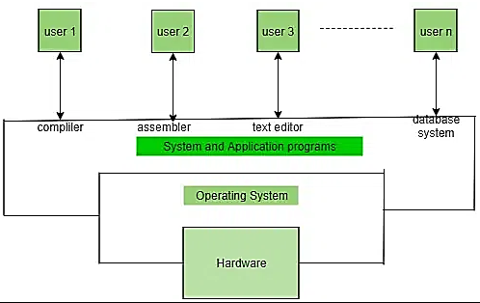

Slide 12
Functions of OS
The operating system manages the Primary Memory or Main Memory.
For a program to be executed, it should be first loaded in the main memory.
An operating system manages the allocation and deallocation of memory to various processes and ensures that the other process does not consume the memory allocated to one process.

Slide 13
Memory Management
An Operating System performs the following activities for memory management:
It keeps track of primary memory, i.e., which bytes of memory are used by which user program. The memory addresses that have already been allocated and the memory addresses of the memory that has not yet been used.
In multiprogramming, the OS decides the order in which processes are granted memory access, and for how long.
It Allocates the memory to a process when the process requests it and deallocates the memory when the process has terminated or is performing an I/O operation.

Slide 14
Process Management
In a multi-programming environment, the OS decides the order in which processes have access to the processor, and how much processing time each process has. This function of OS is called Process Scheduling.
An operating system manages the processor’s work by allocating various jobs to it and ensuring that each process receives enough time from the processor to function properly.

Slide 15
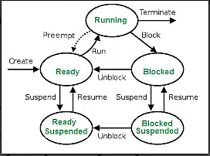

Slide 16
Device Management
An OS manages device communication via its respective drivers. It performs the following activities for device management.
Keeps track of all devices connected to the system. Designates a program responsible for every device known as the Input/Output controller.
Decide which process gets access to a certain device and for how long.
Allocates devices effectively and efficiently. Deallocates devices when they are no longer required.
There are various input and output devices. An OS controls the working of these input-output devices.
It receives the requests from these devices, performs a specific task, and communicates back to the requesting process.

Slide 17
File Management
A file system is organized into directories for efficient or easy navigation and usage.
It keeps track of where information is stored, user access settings, the status of every file, and more.
An OS keeps track of information regarding the creation, deletion, transfer, copy, and storage of files in an organized way.
It also maintains the integrity of the data stored in these files, including the file directory structure, by protecting against unauthorized access.

Slide 18
Process and threads
Processes are basically the programs that are dispatched from the ready state and are scheduled in the CPU for execution.
Process is isolated means it does not share the memory with any other process. The process can have the following states new, ready, running, waiting, terminated, and suspended.
Thread is the segment of a process which means a process can have multiple threads and these multiple threads are contained within a process. A thread has three states: Running, Ready, and Blocked.
The thread takes less time to terminate as compared to the process but unlike the process, threads do not isolate.

Slide 19
Resource allocation and deadlock
In an operating system (OS), resource allocation is the process of meeting the hardware requirements of an application.
Deadlocks can occur when processes get stuck waiting for each other to release resources.
A deadlock is a situation where a set of processes is blocked because each process is holding a resource and waiting for another resource acquired by some other process.
Consider an example when two trains are coming toward each other on the same track and there is only one track, none of the trains can move once they are in front of each other. This is a practical example of deadlock.

Slide 20
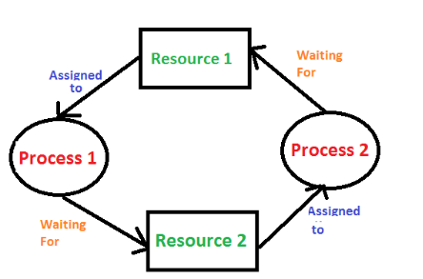
Example

Slide 21
Necessary Conditions for Deadlock in OS
Deadlock can arise if the following four conditions hold simultaneously (Necessary Conditions)
Mutual Exclusion: Two or more resources are non-shareable (Only one process can use at a time).
Hold and Wait: A process is holding at least one resource and waiting for resources.
No Preemption: A resource cannot be taken from a process unless the process releases the resource.
Circular Wait: A set of processes waiting for each other in circular form.

Slide 22
Deadlock Prevention
(i) Mutual Exclusion
We only use the Lock for the non-share-able resources and if the resource is share- able (like read only file) then we not use the locks here. That ensure that in case of share -able resource , multiple process can access it at same time.
Problem- Here the problem is that we can only do it in case of share-able resources but in case of no-share-able resources like printer , we have to use Mutual exclusion.

Slide 23
(ii) Hold and Wait
To ensure that Hold and wait never occurs in the system, we must guarantee that whenever process request for resource , it does not hold any other resources.
we can provide the all resources to the process that is required for it’s execution before starting it’s execution.
problem – for example if there are three resource that is required by a process and we have given all that resource before starting execution of process then there might be a situation that initially we required only two resource and after one hour we want third resources and this will cause starvation for the another process that wants this resources and in that waiting time that resource can allocated to other process and complete their execution.

Slide 24
We can ensure that when a process request for any resources that time the process does not hold any other resources. Ex- Let there are three resources DVD, File and Printer . First the process request for DVD and File for the copying data into the file and let suppose it is going to take 1 hour and after it the process free all resources then again request for File and Printer to print that file.

Slide 25
(iii) No Preemption
If a process is holding some resource and request on other resources that are acquired and these resource are not available immediately then the resources that current process is holding are preempted. After some time process again request for the old resources and other required resources to re-start.
For example – Process p1 have resource r1 and requesting for r2 that is hold by process p2. then process p1 preempt r1 and after some time it try to restart by requesting both r1 and r2 resources.

Slide 26
(iv) Circular Wait:
To remove the circular wait in system we can give the ordering of resources in which a process needs to acquire.
Ex: If there are process p1 and p2 and resources r1 and r2 then we can fix the resource acquiring order like the process first need to acquire resource r1 and then resource r2. so the process that acquired r1 will be allowed to acquire r2 , other process needs to wait until r1 is free.

Slide 27
Introduction to Algorithms
The word Algorithm means ” A set of finite rules or instructions to be followed in calculations or other problem-solving operations ”
A procedure for solving a mathematical problem in a finite number of steps that frequently involves recursive operations
The Algorithm designed are language-independent, i.e. they are just plain instructions that can be implemented in any language, and yet the output will be the same, as expected.

Slide 28
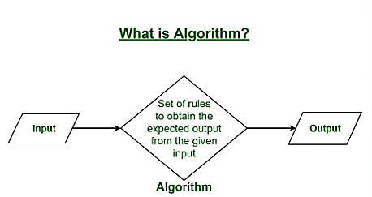

Slide 29
Need of Algorithms
Algorithms are necessary for solving complex problems efficiently and effectively.
They help to automate processes and make them more reliable, faster, and easier to perform.
Algorithms also enable computers to perform tasks that would be difficult or impossible for humans to do manually.
They are used in various fields such as mathematics, computer science, engineering, finance, and many others to optimize processes, analyze data, make predictions, and provide solutions to problems.

Slide 30
Characteristics of Algorithms
Clear and Unambiguous: The algorithm should be unambiguous. Each of its steps should be clear in all aspects and must lead to only one meaning.
Well-Defined Inputs: If an algorithm says to take inputs, it should be well-defined inputs. It may or may not take input.
Well-Defined Outputs: The algorithm must clearly define what output will be yielded and it should be well-defined as well. It should produce at least 1 output.

Slide 31
Feasible: The algorithm must be simple, generic, and practical, such that it can be executed with the available resources. It must not contain some future technology or anything.
Language Independent: The Algorithm designed must be language-independent, i.e. it must be just plain instructions that can be implemented in any language, and yet the output will be the same, as expected.
Input: An algorithm has zero or more inputs. Each that contains a fundamental operator must accept zero or more inputs.
Output: An algorithm produces at least one output. Every instruction that contains a fundamental operator must accept zero or more inputs.

Slide 32
Definiteness: All instructions in an algorithm must be unambiguous, precise, and easy to interpret. By referring to any of the instructions in an algorithm one can clearly understand what is to be done. Every fundamental operator in instruction must be defined without any ambiguity.
Finiteness: An algorithm must terminate after a finite number of steps in all test cases. Every instruction which contains a fundamental operator must be terminated within a finite amount of time. Infinite loops or recursive functions without base conditions do not possess finiteness.
Effectiveness: An algorithm must be developed by using very basic, simple, and feasible operations so that one can trace it out by using just paper and pencil.

Slide 33
Properties of Algorithms
It should terminate after a finite time.
It should produce at least one output.
It should take zero or more input.
It should be deterministic means giving the same output for the same input case.
Every step in the algorithm must be effective i.e. every step should do some work.

Slide 34
Brute force algorithm
A brute force algorithm is a simple, comprehensive search strategy that systematically explores every option until a problem’s answer is discovered.
It’s a generic approach to problem-solving that’s employed when the issue is small enough to make an in-depth investigation possible.
However, because of their high temporal complexity, brute force techniques are inefficient for large-scale issues.

Slide 35
Methodical Listing: Brute force algorithms investigate every potential solution to an issue, usually in an organized and detailed way. This involves attempting each option in a specified order.
Relevance: When the issue space is small and easily explorable in a fair length of time, brute force is the most appropriate method. The temporal complexity of the algorithm becomes unfeasible for larger issue situations.
Not using optimization or heuristics: Brute force algorithms don’t use optimization or heuristic approaches. They depend on testing every potential outcome without ruling out any using clever pruning or heuristics.

Slide 36
Pros:
The brute force approach is a guaranteed way to find the correct solution by listing all the possible candidate solutions for the problem.
It is a generic method and not limited to any specific domain of problems.
The brute force method is ideal for solving small and simpler problems.
It is known for its simplicity and can serve as a comparison benchmark.

Slide 37
Cons:
The brute force approach is inefficient. For real-time problems, algorithm analysis often goes above the O(N!) order of growth.
This method relies more on compromising the power of a computer system for solving a problem than on a good algorithm design.
Brute force algorithms are slow.
Brute force algorithms are not constructive or creative compared to algorithms that are constructed using some other design paradigms.

Slide 38
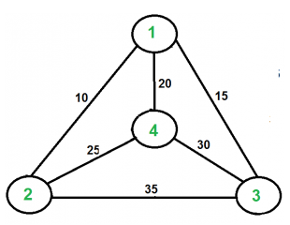
Example – Travelling salesman problem
Given a set of cities and distances between every pair of cities, the problem is to find the shortest possible route that visits every city exactly once and returns to the starting point.

Slide 39
A TSP tour in the graph is 1-2-4-3-1. The cost of the tour is 10+25+30+15 which is 80.
Generate all (n-1)! permutations of cities.
Calculate the cost of every permutation and keep track of the minimum cost permutation.
Return the permutation with minimum cost.

Slide 40
Recursive algorithm
The process in which a function calls itself directly or indirectly is called recursion and the corresponding function is called a recursive function.
A recursive function solves a particular problem by calling a copy of itself and solving smaller sub problems of the original problems.
It can reduce the length of our code and make it easier to read and write.
A task that can be defined with its similar subtask, recursion is one of the best solutions for it.
For example; The Factorial of a number.
Notes:
Examples of such problems are Towers of Hanoi (TOH), Inorder/Preorder/Postorder Tree Traversals, DFS of Graph, etc.

Slide 41
Properties of Recursion:
Performing the same operations multiple times with different inputs.
In every step, we try smaller inputs to make the problem smaller.
Base condition is needed to stop the recursion otherwise infinite loop will occur.

Slide 42
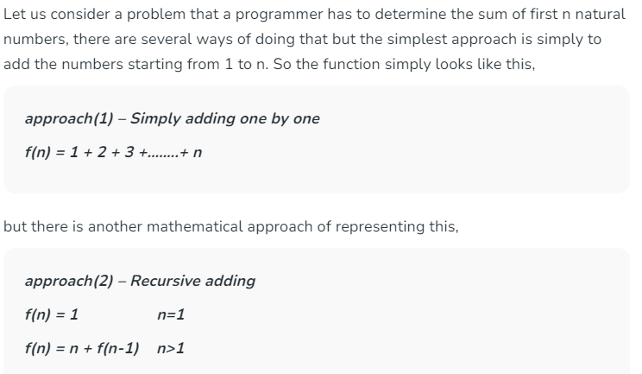

Slide 43
Recursion uses more memory, because the recursive function adds to the stack with each recursive call, and keeps the values there until the call is finished.
The recursive function uses LIFO (LAST IN FIRST OUT) Structure just like the stack data structure.
In the recursive program, the solution to the base case is provided and the solution to the bigger problem is expressed in terms of smaller problems.

Slide 44
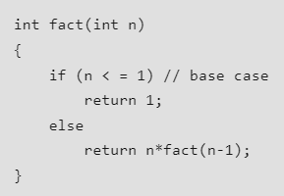
In the above example, the base case for n < = 1 is defined and the larger value of a number can be solved by converting to a smaller one till the base case is reached.
If the base case is not reached or not defined, then the stack overflow problem may arise.

Slide 45
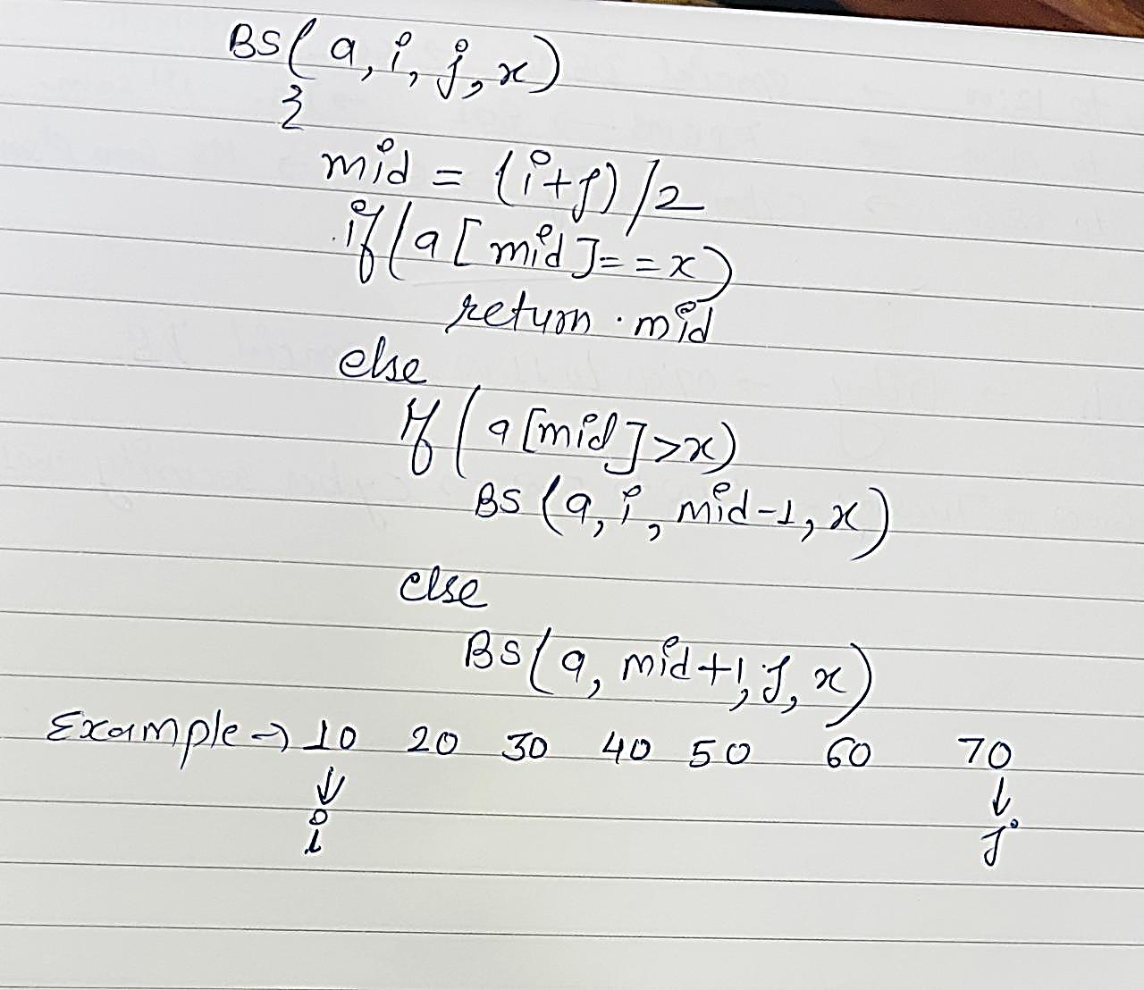
Binary Search Tree example

Slide 46
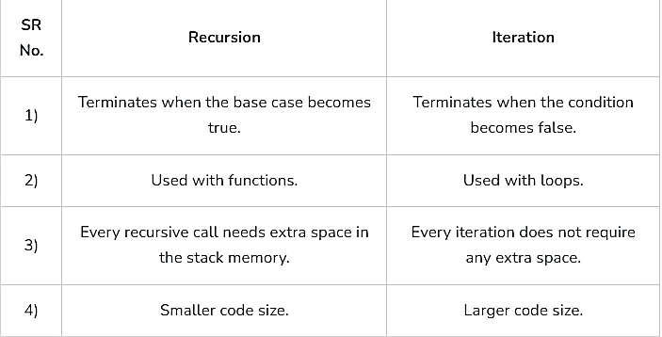

Slide 47
Divide and Conquer Algorithm
It is a problem-solving technique used to solve problems by dividing the main problem into sub problems, solving them individually and then merging them to find solution to the original problem.
1. Divide:
Break down the original problem into smaller subproblems.
Each subproblem should represent a part of the overall problem.
The goal is to divide the problem until no further division is possible.
2. Conquer:
Solve each of the smaller subproblems individually.
If a subproblem is small enough (often referred to as the “base case”), we solve it directly without further recursion.
The goal is to find solutions for these subproblems independently.

Slide 48
3. Merge:
Combine the sub-problems to get the final solution of the whole problem.
Once the smaller subproblems are solved, we recursively combine their solutions to get the solution of larger problem.
The goal is to formulate a solution for the original problem by merging the results from the subproblems.
Example – Quick sort, merge sort

Slide 49
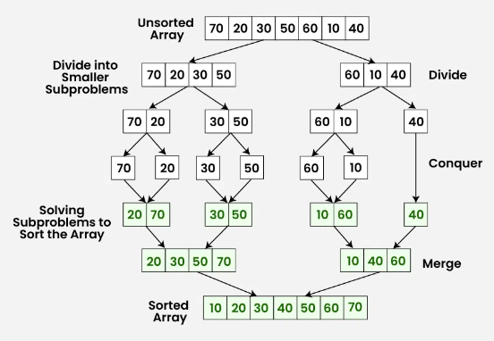

Slide 50
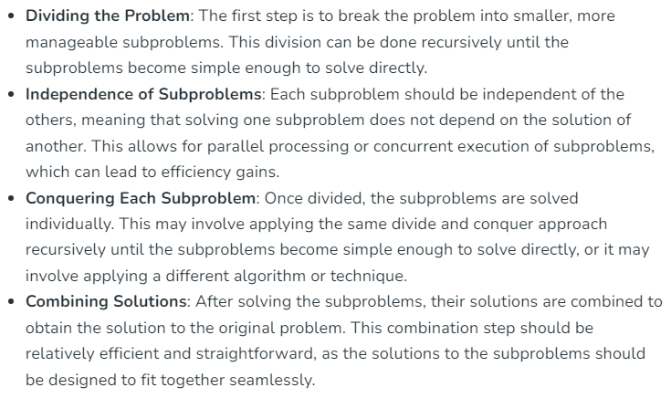
Characteristics

Slide 51
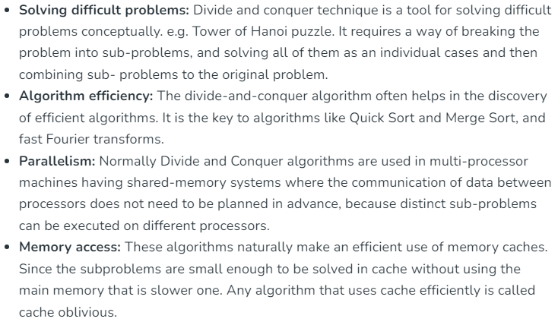
Advantages

Slide 52
Sorting Algorithms
Sorting refers to rearrangement of a given array or list of elements according to a comparison operator on the elements.
The comparison operator is used to decide the new order of elements in the respective data structure.
Sorting means reordering of all the elements either in ascending or in descending order.

Slide 53
Bubble sort
Bubble Sort is the simplest sorting algorithm that works by repeatedly swapping the adjacent elements if they are in the wrong order. This algorithm is not suitable for large data sets as its average and worst-case time complexity is quite high.
Lets consider the following array as an example: arr[] = {5, 1, 4, 2, 8}

Slide 54
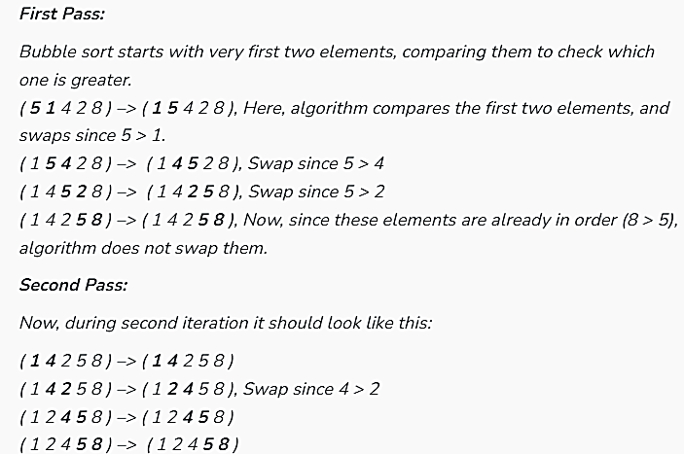

Slide 55
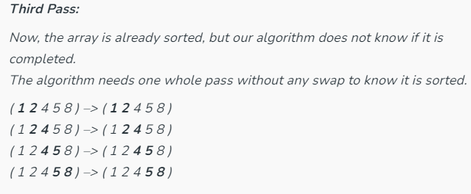

Slide 56
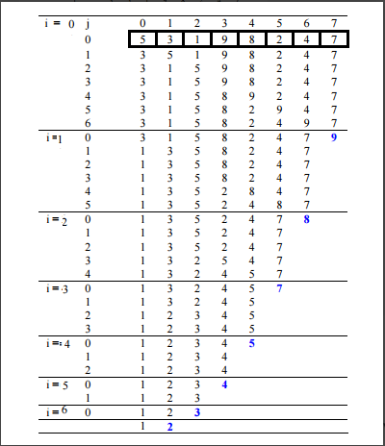

Slide 57
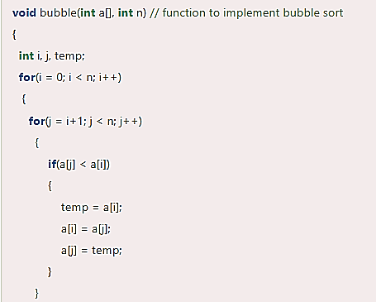

Slide 58
Selection sort
Selection sort is another sorting technique in which we find the minimum element in every iteration and place it in the array beginning from the first index.
Thus, a selection sort also gets divided into a sorted and unsorted subarray.
Lets consider the following array as an example: arr[] = {64, 25, 12, 22, 11}

Slide 59
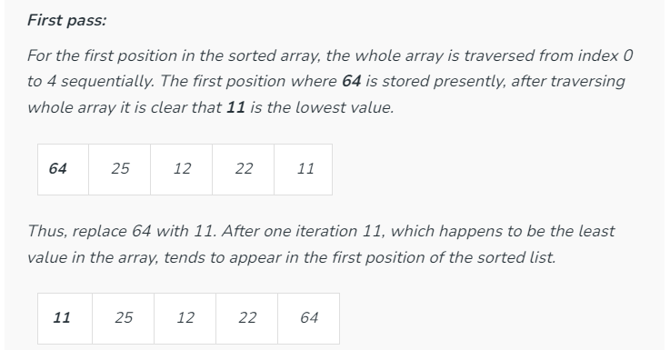

Slide 60
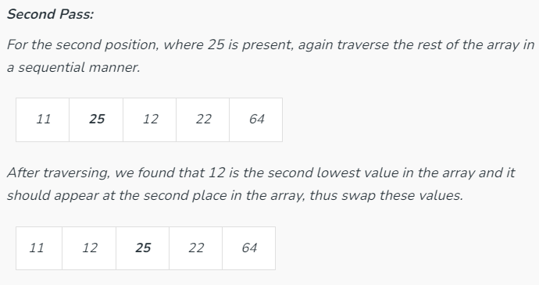

Slide 61
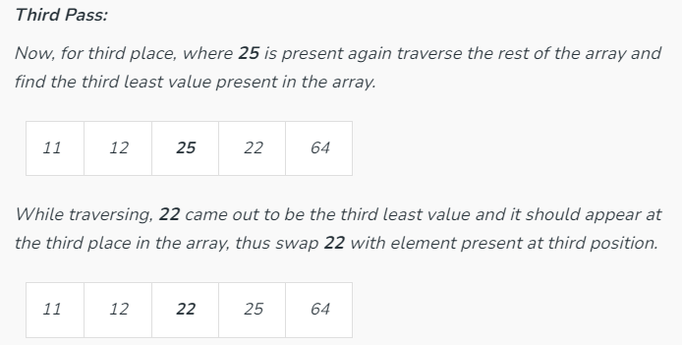

Slide 62
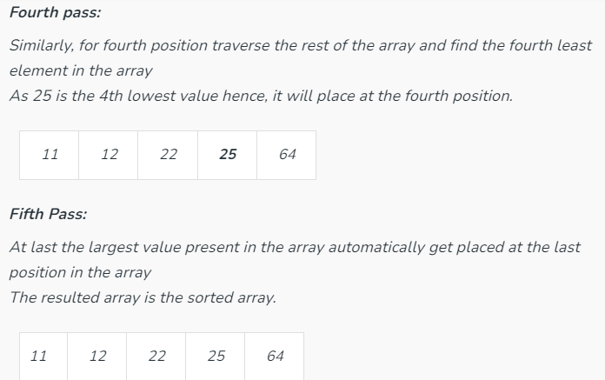

Slide 63
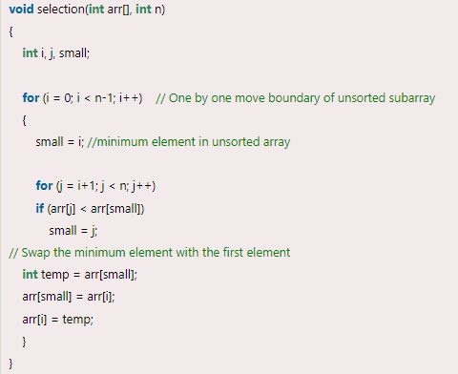

Slide 64
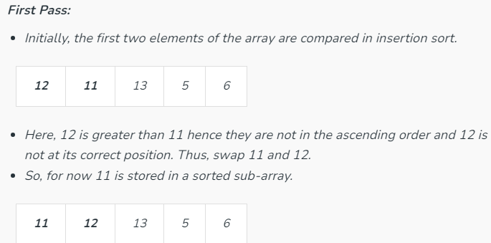
Insertion Sort
Insertion sort is a simple sorting algorithm that works similarly to the way you sort playing cards in your hands.
Consider an example: arr[]: {12, 11, 13, 5, 6}

Slide 65
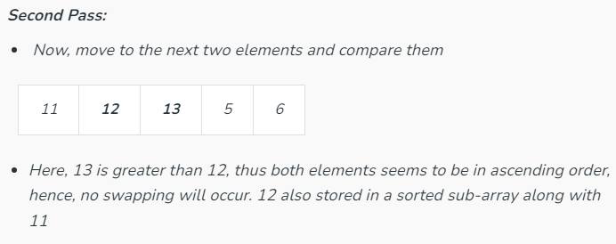

Slide 66
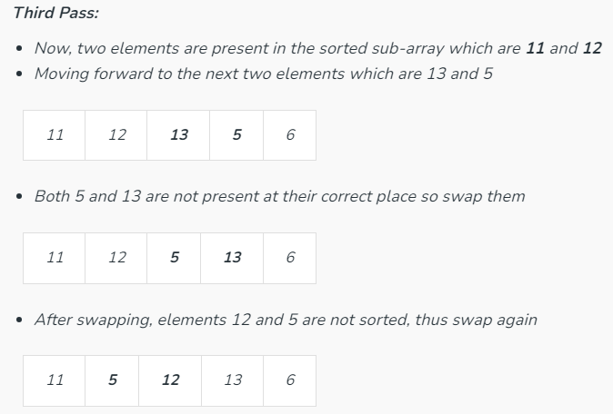

Slide 67
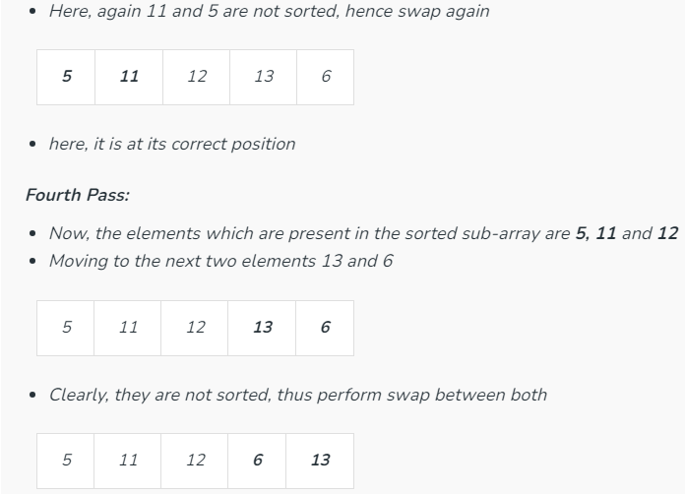

Slide 68
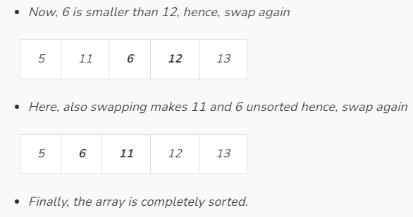

Slide 69
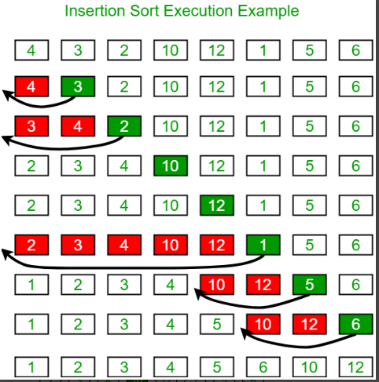

Slide 70
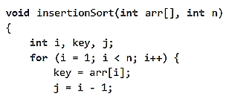
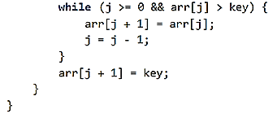

Slide 71
Quick sort
QuickSort is a sorting algorithm based on the Divide and Conquer algorithm that picks an element as a pivot and partitions the given array around the picked pivot by placing the pivot in its correct position in the sorted array.
The key process in quickSort is a partition() . The target of partitions is to place the pivot (any element can be chosen to be a pivot) at its correct position in the sorted array and put all smaller elements to the left of the pivot, and all greater elements to the right of the pivot.
Partition is done recursively on each side of the pivot after the pivot is placed in its correct position and this finally sorts the array.

Slide 72
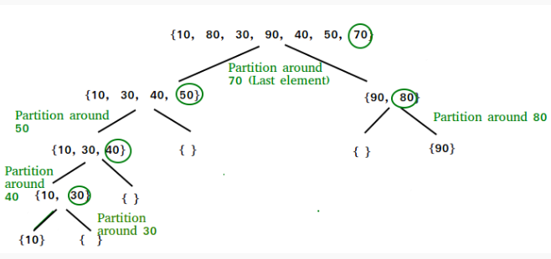

Slide 73
Choice of Pivot:
There are many different choices for picking pivots.
Always pick the first element as a pivot.
Always pick the last element as a pivot.
Pick a random element as a pivot.
Pick the middle as the pivot.
Consider the array – 10,16,8,12,15,6,3,9,5
Notes:
https://www.youtube.com/watch?v=7h1s2SojIRw

Slide 74
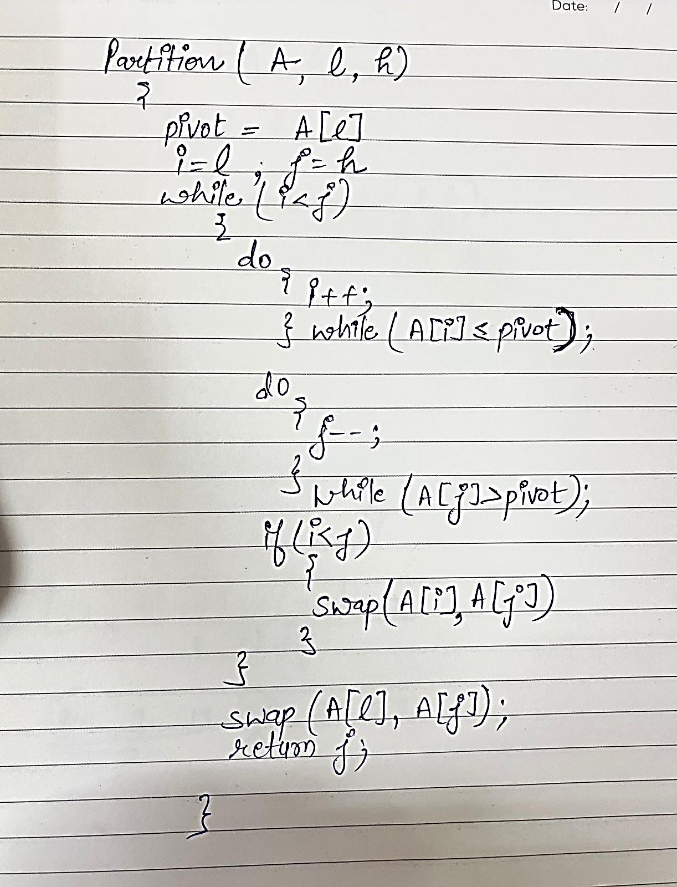
Consider the array –
24, 9, 29, 14, 19, 27

Slide 75
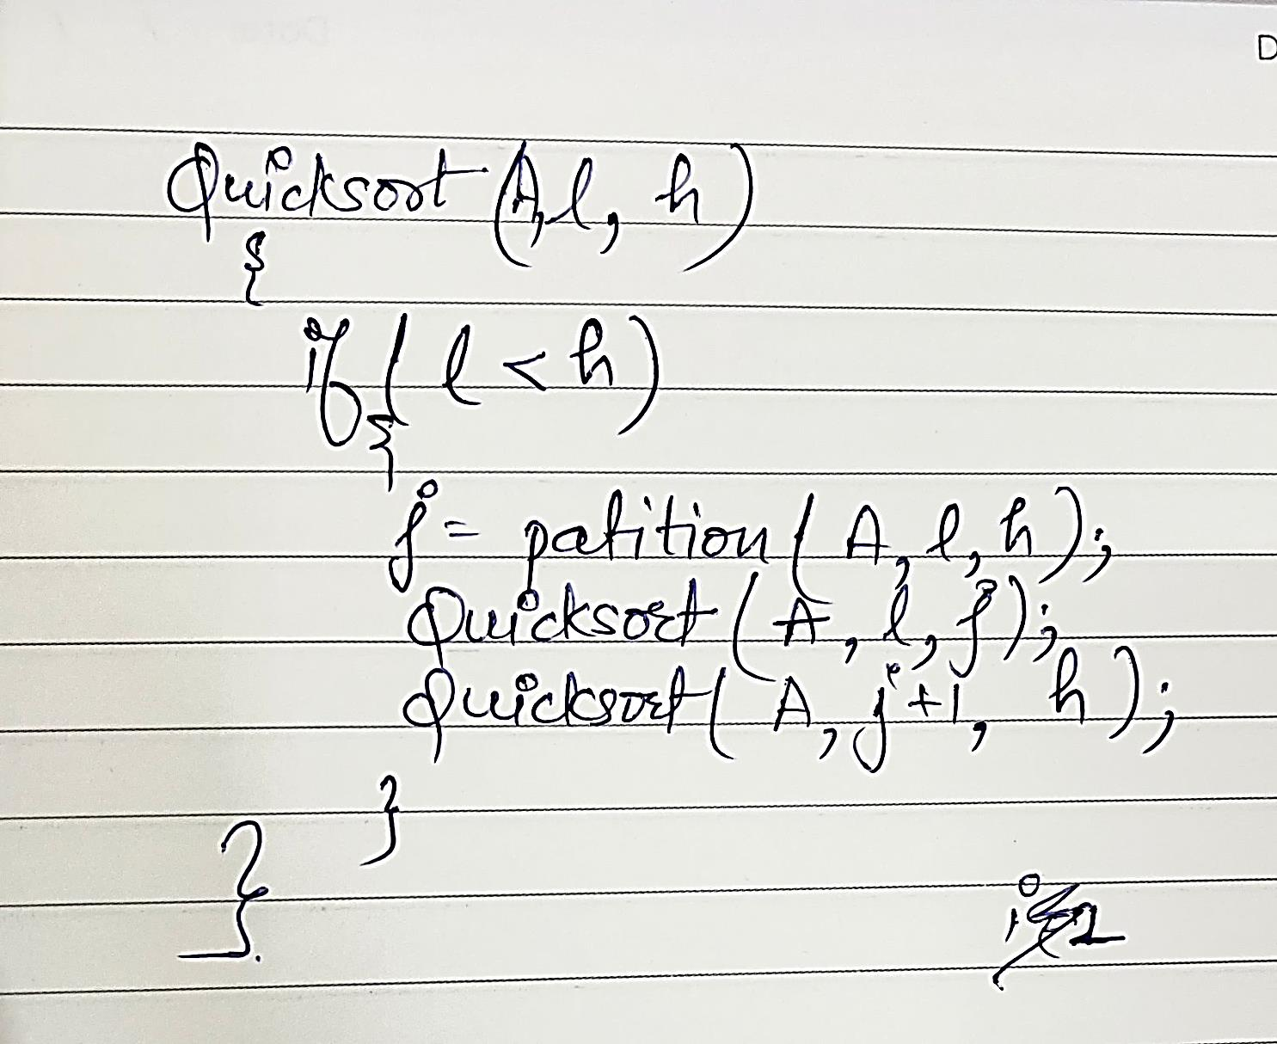

Slide 76
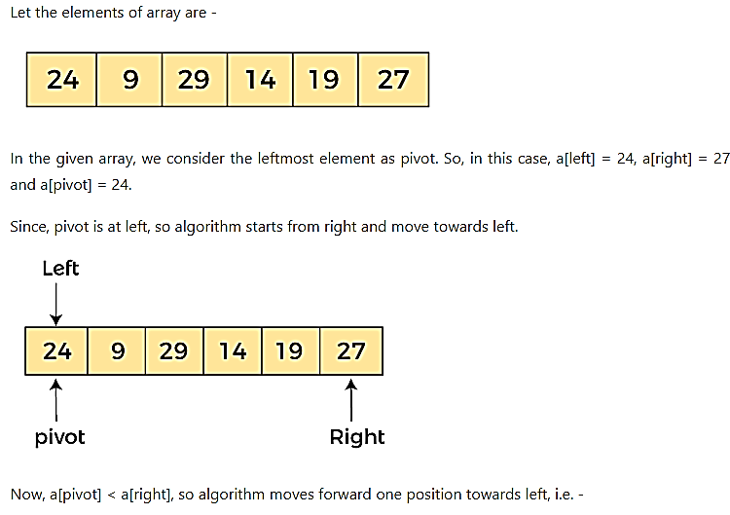

Slide 77
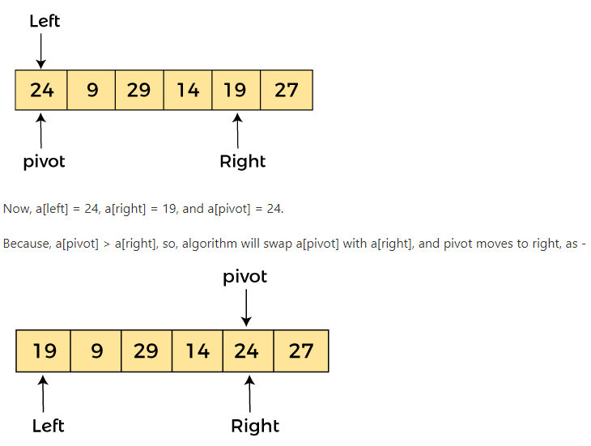
Now, a[left] = 19, a[right] = 24, and a[pivot] = 24. Since, pivot is at right, so algorithm starts from left and moves to right.

Slide 78
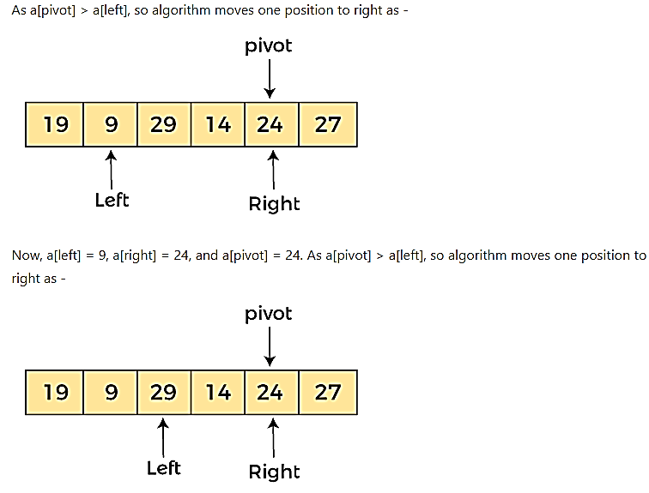
Now, a[left] = 29, a[right] = 24, and a[pivot] = 24. As a[pivot] < a[left], so, swap a[pivot] and a[left], now pivot is at left, i.e. -

Slide 79
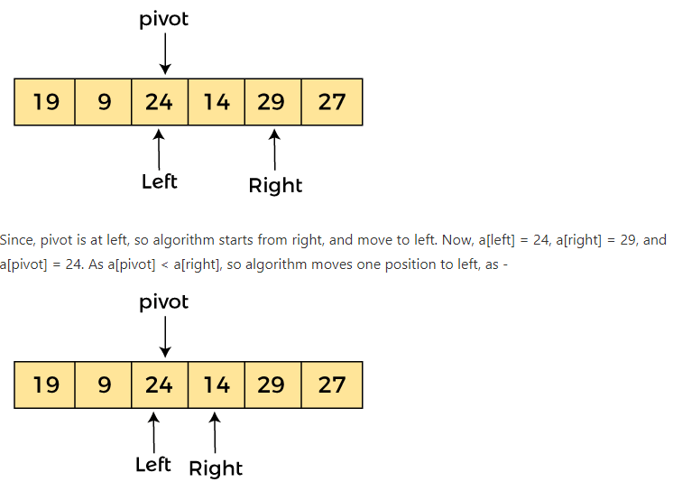
Now, a[pivot] = 24, a[left] = 24, and a[right] = 14. As a[pivot] > a[right], so, swap a[pivot] and a[right], now pivot is at right, i.e. -

Slide 80
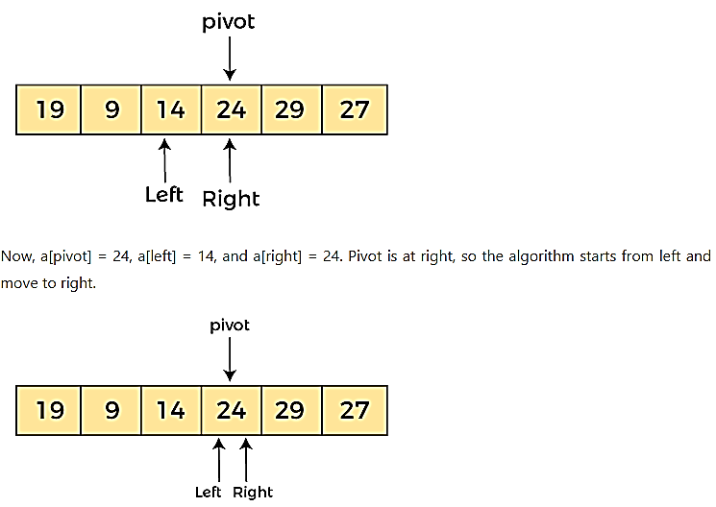

Slide 81
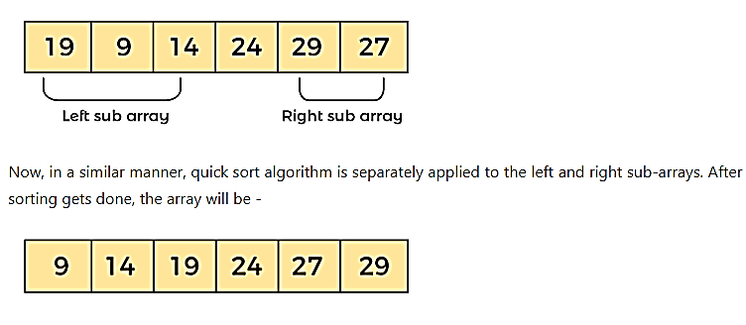
Now, a[pivot] = 24, a[left] = 24, and a[right] = 24. So, pivot, left and right are pointing the same element. It represents the termination of procedure.
Element 24, which is the pivot element is placed at its exact position.
Elements that are right side of element 24 are greater than it, and the elements that are left side of element 24 are smaller than it.

